Slide 1

SepsisGuard
FINAL YEAR PROJECT REVIEW
An AI and IoT-Driven Early Sepsis Warning Wearable System for Rural Hospitals
Presented By : Anaas Rawoof S (23619102) · Arvin M (23619104) · Vishal D (23619146)
Mentor : Dr. Manikandan. A · Dept. of AI & ML, VISTAS, Chennai

Slide 2
Abstract
SepsisGuard is a low-cost wearable early-warning prototype. It measures continuously, decides on the device, and streams the same data to a ward dashboard.
Measure
Decide on the watch
Stream
TMP117 temperature, MAX30102 pulse and MPU6050 motion sensors share one I²C bus on a XIAO ESP32-C3.
Warning when T > 34.0 °C or |θ| > 90°. Buzzer and OLED respond with no network, server or browser.
Text telemetry over USB serial to a browser dashboard. A BLE gateway is planned for Phase 2.
A decision-support prototype, not a diagnostic device.
SepsisGuard · 02

Slide 3
Problem statement
Observation gaps
Fragile networks
Vitals are charted at scheduled rounds. Nothing is measured in between, and the gap is invisible on the chart.
A warning that depends on Wi-Fi, power or a server fails where it is needed most.
Alarm fatigue
Cost and honesty
Alarms that fire too often get ignored, so limits must be explicit, adjustable and acknowledgeable.
Hardware must be cheap and simple, and claims must stay within what a student prototype can support.
SepsisGuard · 03

Slide 4
Objectives
Build a wearable node for temperature, pulse signal and orientation on one I²C bus.
Evaluate warning limits on the device and drive a local buzzer and OLED alert.
Provide a four-screen watch interface operated by one push button.
Define a text protocol that works over USB serial now and BLE later.
Build a browser ward dashboard: live cards, trends, alert banner, ledger, reports, export.
Design the Android gateway (Phase 2) and document the limits honestly.
SepsisGuard · 04

Slide 5
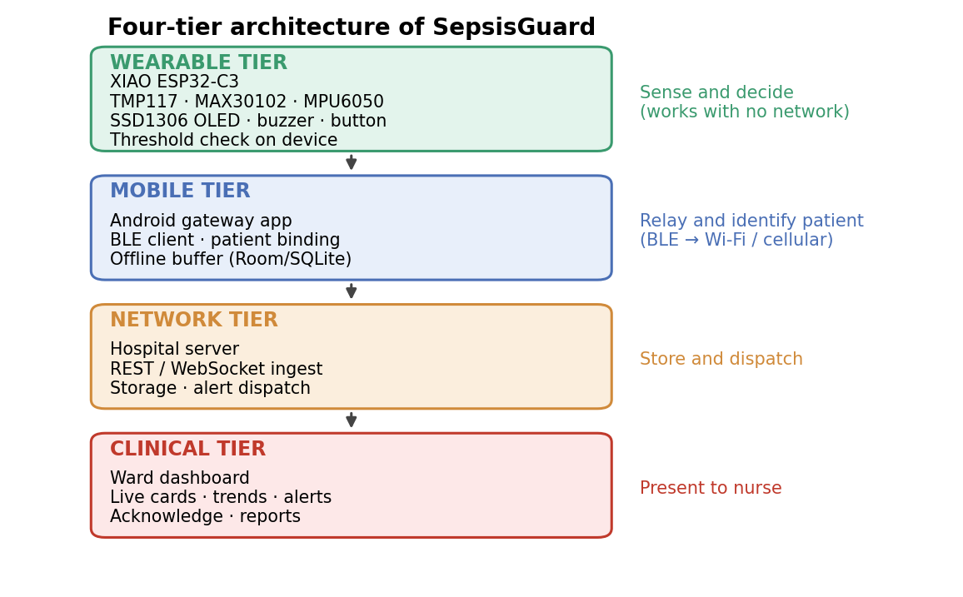
System architecture
Wearable: senses and decides
Mobile gateway: relays and buffers (Phase 2)
Backend: validates and stores records
Dashboard: shows cards, charts and alerts
Figure 1.1, SepsisGuard report
SepsisGuard · 05

Slide 6
Components used
Component | Role in the system
XIAO ESP32-C3 Mini | 32-bit RISC-V controller, 160 MHz, Bluetooth 5 LE
TMP117 | Digital temperature sensor, ±0.1 °C typical
MAX30102 | Optical pulse (PPG) sensor
MPU6050 | Motion sensor giving the tilt angle
SSD1306 OLED | Four watch screens and warning display
Active buzzer (GPIO8) | Local audible alarm
Push button (GPIO5) | Cycles the OLED screens
Web dashboard | HTML, CSS, JavaScript with Web Serial
SepsisGuard · 06

Slide 7
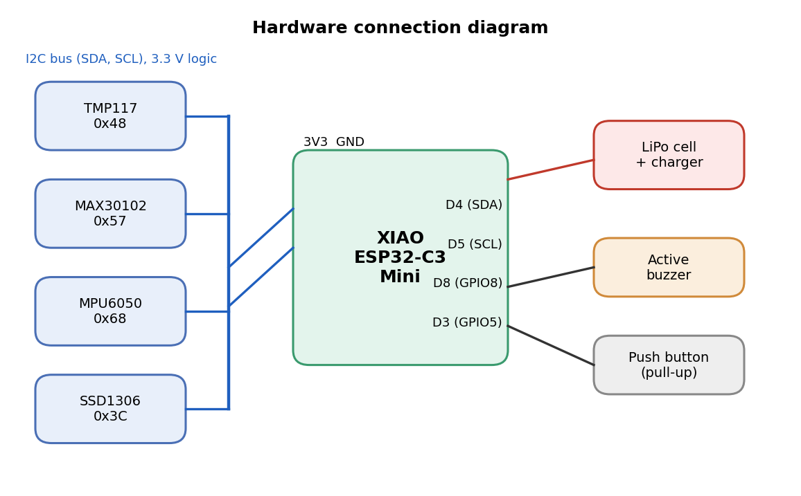
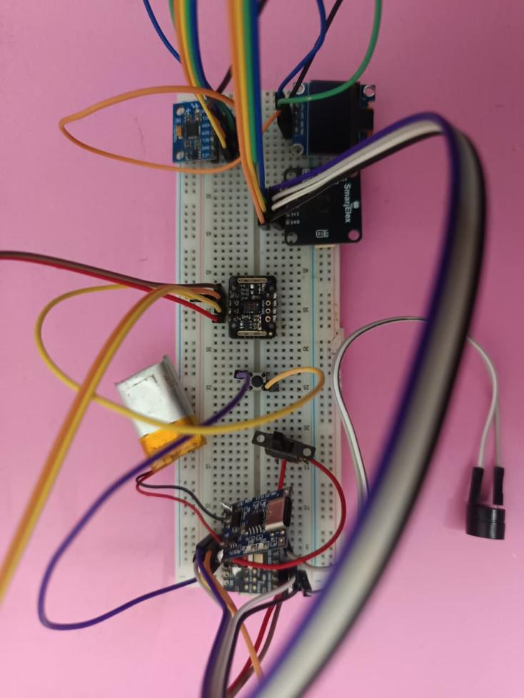
Hardware and prototype
Hardware connection diagram (Figure 3.3) and the assembled prototype (Figure 3.4). All four I²C devices share GPIO6 (SDA) and GPIO7 (SCL).
SepsisGuard · 07

Slide 8
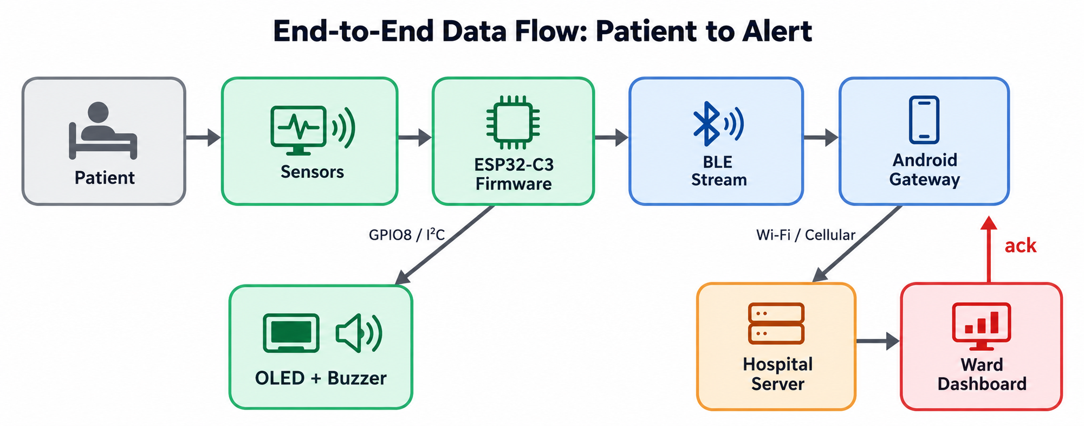
Workflow of components
SepsisGuard · 08

Slide 9
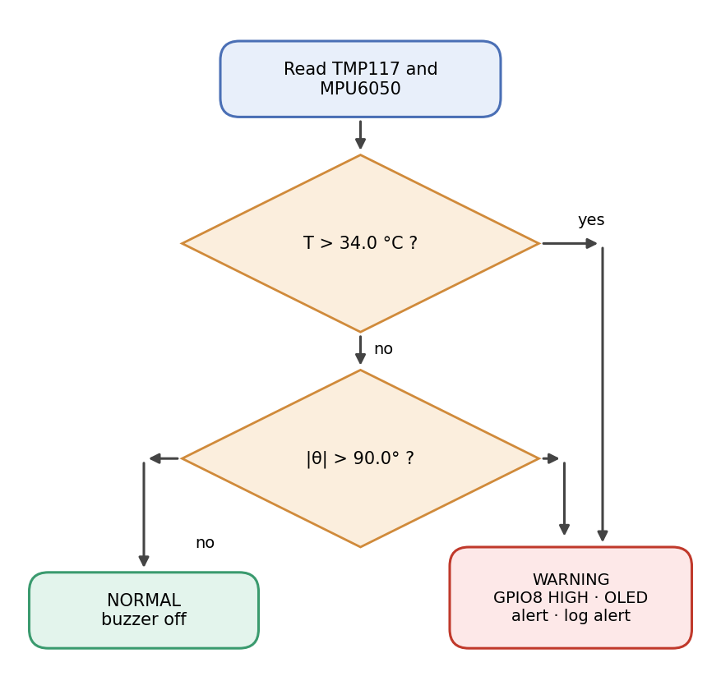
Early-warning logic on the device
Warning = (T > 34.0 °C) OR (|θ| > 90.0°)
Strict comparisons: exactly 34.0 °C or 90.0° is Normal
Demonstration setpoints, adjustable in the dashboard
On breach: GPIO8 buzzer and OLED warning
Dashboard raises a red banner, a tone and a ledger entry
SepsisGuard · 09

Slide 10
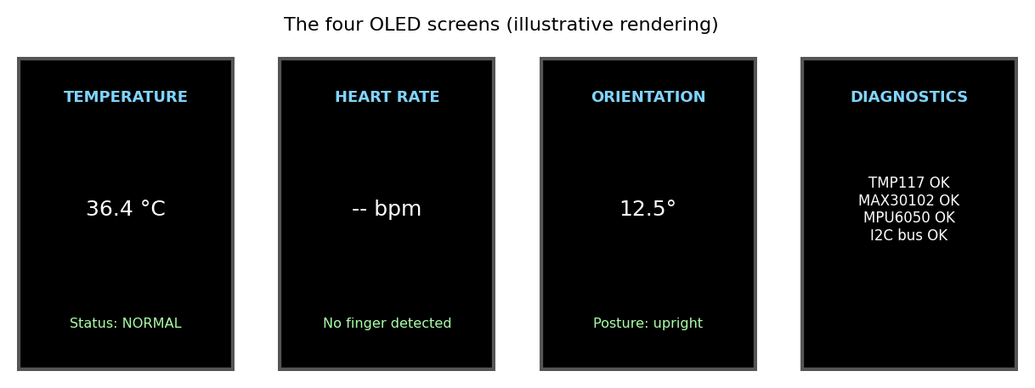
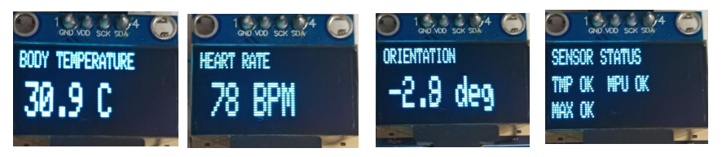
Watch interface
Temperature
Heart rate
Orientation
Diagnostics
Live value with status
BPM and finger detected
Tilt angle and posture
Sensor and bus status
Illustrative rendering (Figure 3.8). One button cycles the screens in order.
SepsisGuard · 10

Slide 11
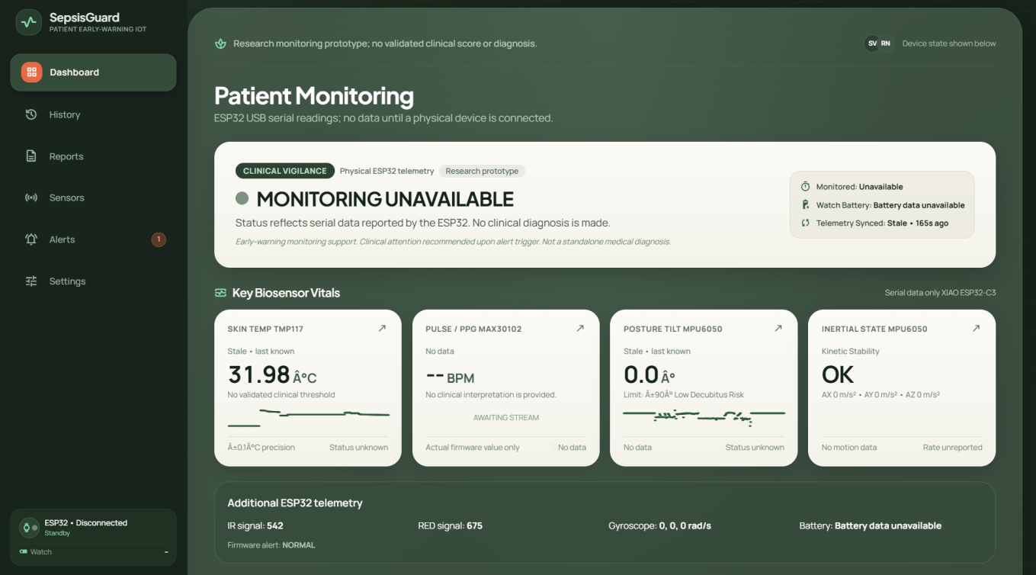
Dashboard: Overview
Live cards follow incoming values
Header shows connection state
Missing heart-rate sensor shows as disconnected, never as a number
Real dashboard screenshot (Figure 6.2)
SepsisGuard · 11

Slide 12
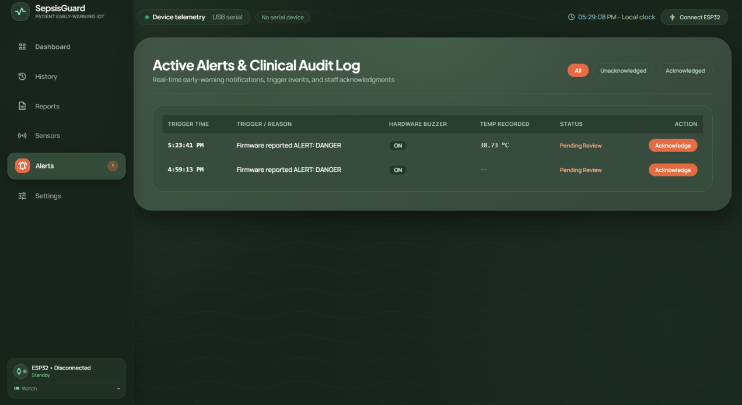
Dashboard: Alerts
Red banner with a synthesised tone
Alert ledger with timestamps
Acknowledge an alert; it clears when readings return
Real dashboard screenshot (Figure 6.4)
SepsisGuard · 12

Slide 13
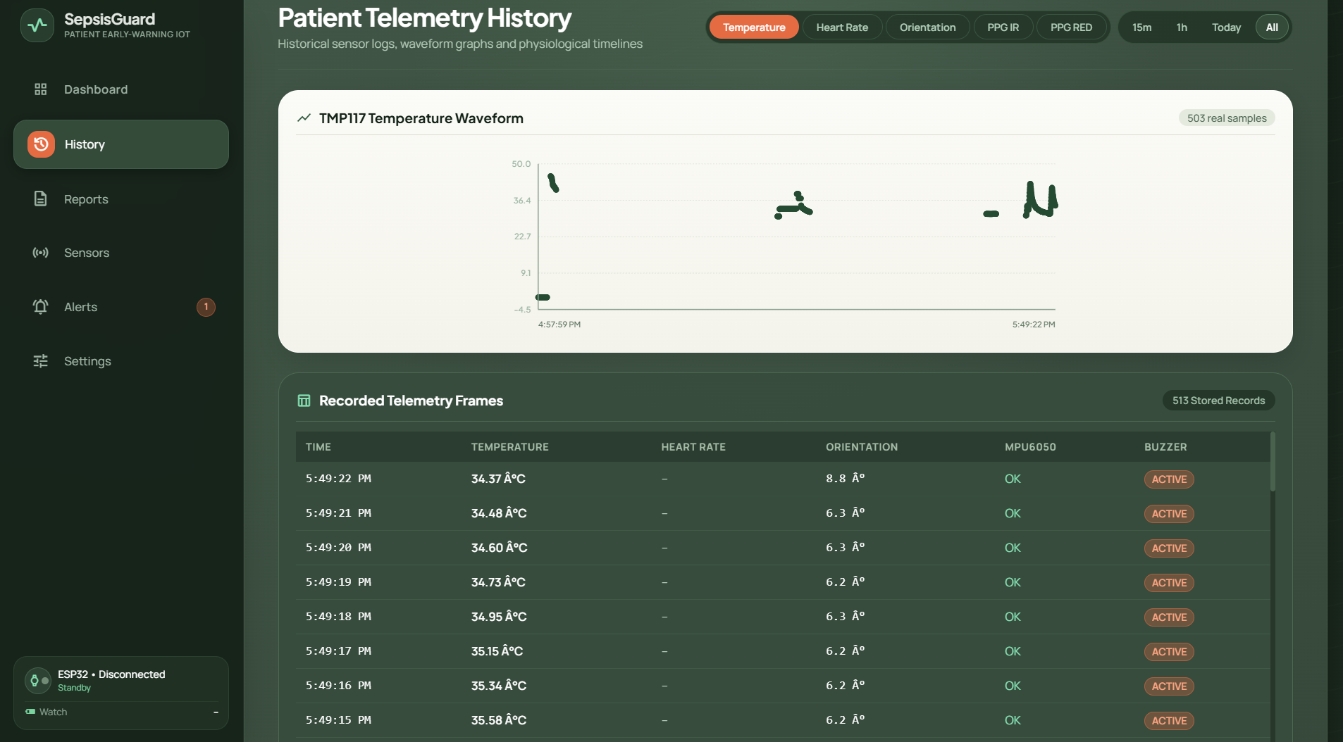
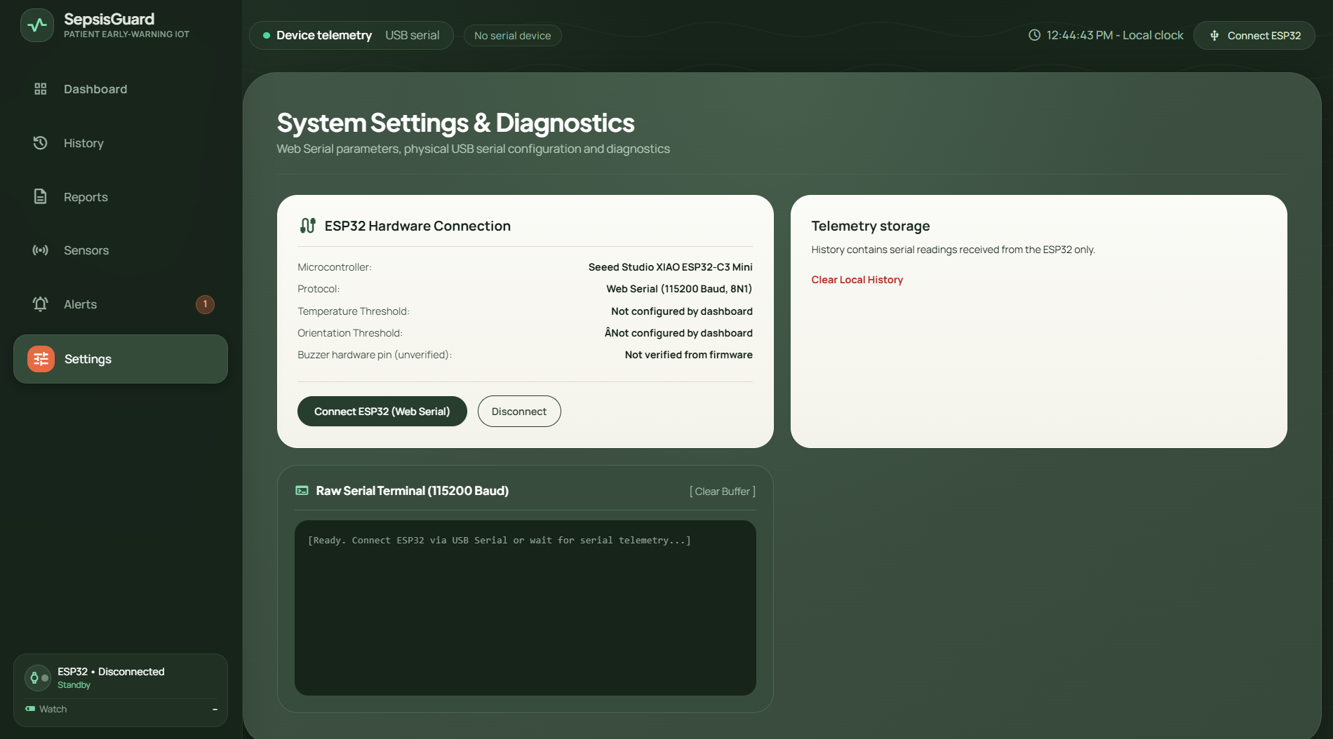
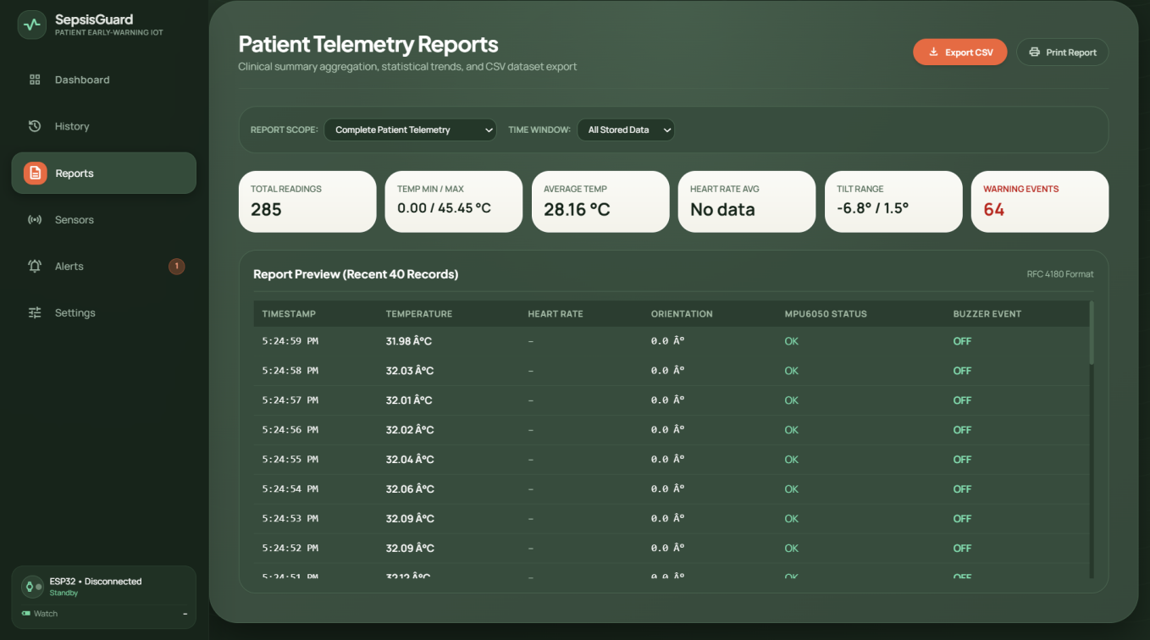
Dashboard: Trends, Settings, Reports
Trends
Settings
Reports
Temperature and tilt history charts
Adjustable temperature and tilt limits
Session history and alerts exported to a file
SepsisGuard · 13

Slide 14
End-to-end workflow
1. Sense
2. Decide
3. Stream
4. Display
5. Alert and audit
Sensors read skin temperature, pulse light and acceleration over I²C.
Firmware converts to °C, BPM and tilt, checks the limits, and sounds the buzzer.
Each reading cycle is printed as text over USB serial.
Dashboard updates cards, charts and status badges.
Tone, alert badge and a timestamped ledger entry.
Phase 2: an Android gateway will bind the watch to a patient, buffer data offline and forward records to the hospital server.
SepsisGuard · 14

Slide 15
Testing and validation status
0.12 °C
120 ms
500 ms
3.5%
Mean absolute error vs a reference thermometer (5 points)
Mean local buzzer latency (5 trials)
Mean dashboard banner latency (5 trials)
Node cost of ₹3,500 against a ₹1,00,000 monitor
Functional checks
Cable unplugged
Not claimed
All 12 checks have recorded observations: warnings, dashboard alert, acknowledgement, reload and export worked. MAX30102 was not fitted.
The dashboard connection is lost. Local alarm behaviour depends on the firmware configuration.
No patient testing and no battery endurance figure. Heart-rate accuracy is not characterised.
SepsisGuard · 15

Slide 16
Limitations and future work
Limitations
Future work
Demonstration rule, not a clinical score · Skin temperature is not core temperature · No respiratory rate, blood pressure or SpO₂ · Bench tests only, no patient testing · USB cable and Chromium browser needed · Gateway not yet built
Android BLE gateway (Phase 2) · Validated score such as NEWS2 · Characterise the MAX30102 · Secure hospital server · Compact PCB and enclosure · Ethics-approved pilot
SepsisGuard · 16

Slide 17
Conclusion
A wearable that decides locally and streams the same data to a dashboard is a workable, inexpensive architecture for bedside early warning.
Local alarm
Text protocol
Honest limits
Works without a network, server or browser.
Transport can change without changing the dashboard.
A decision-support prototype, not a diagnosis.
Thank you · Questions
SepsisGuard · 17

